Slide 1
Atmospheric Corrosion of Metallic Structure
: A multibillion corrosion impact menace
Dr G H Thanki
Director & Principal Consultant
Corrosion Control & Monitoring Consultancy
Vadodara
www.corrosionawreness.com
Lecture delivered as course leader
During Two day Programme on
“Advanced Corrosion Management 2014”
Mumbai on 30th & 31st Jan 2014
Organized by
Indian Knowledge Center

Slide 2
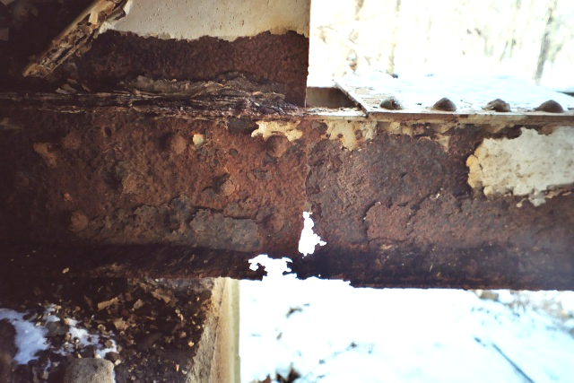
Perhaps the most serious structural problem is the RUST
that has nearly eaten away half the lower cord
under the bridge.

Slide 3
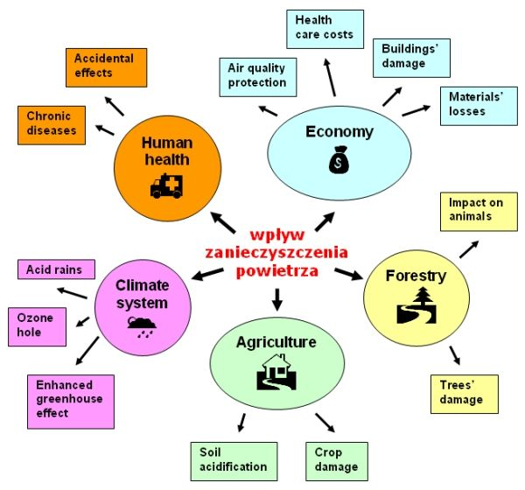
Impact of air pollution
Atmospheric Corrosion Effect
Atmospheric Corrosion Effect
Impact of Air Pollution
Impact of Air Pollution

Slide 4
Atmospheric corrosion -costs
It is estimated that in the U.S. alone direct cost of atmospheric corrosion to the industry, government and consumers amounts to about
$ 20 billion annually.

Slide 5
Cost of Corrosion

Slide 6
Indirect damages
Indirect damages are almost impossible to express in terms of $ value since they consist of such:
Important resources as energy needed to manufacture replacements for corroded objects,
Humans killed or disabled as a result of failures of corroded structures,
Artifacts lost as a result of corrosive attack, etc.

Slide 7
Indirect damages
Atmospheric corrosion is not a very clearly defined subject.
It occupies the territory between ‘immersed corrosion’ and ‘dry oxidation’, since metals may be exposed to damp atmospheres or may be subjected to the full force of the weather.
It is usually taken to include packaging and storage, painting and preparation for painting, and the effects of climate and air purity.

Slide 8
Compound → Metal
The more common metals exist in nature as metallic compounds.
The principal compounds or ores are oxides and sulphides.
The extraction process is:
Compound → Metal
Metals spontaneously react with any liquid or gaseous environment in which they are placed and a corrosion product is produced which is very similar to the original ore from which the metal was obtained.

Slide 9
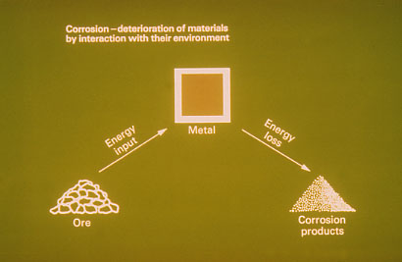
Corrosion – deterioration of materials by interaction with their environment

Slide 10
Thus:
Iron Ore = Iron Oxide
Iron Oxide + chemically bonded water = Rust
Corrosion processes are chemical reactions taking place at the surface of the metal.
They obey well-established chemical laws.

Slide 11
dry corrosion
Corrosion products may act as a barrier between the metal and its surroundings, effectively slowing down the corrosion rate.
This phenomenon is frequently observed when metals corrode in air, a process known as
"dry corrosion".

Slide 12

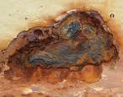
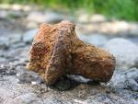

We have all seen corrosion and know that the process
- a new and less desirable material from the original metal- and result in a loss of function of the component or system.
The corrosion product we see most commonly is the rust which forms on the surface of steel and somehow
Steel→ Rust
Ugly faces of rusted surface of metals

Slide 13
It cannot be expected to happen when the corrosion products are soluble and the corrosion is taking place in an aqueous environment, i.e. "wet corrosion".
e.g., in a dry environment:
Zinc + Oxygen ® Zinc Oxide + Water + Oxygen
Nothing much happens!
But add acid condensate (as frequently occurs in industrial environments) and
Zinc Oxide + Sulphuric Acid → Zinc Sulphate + Water →eases away, exposing Zinc.

Slide 14
DRY CORROSION
At room temperature, most metals carry a very thin oxide layer as a result of the metal's reaction with oxygen in the atmosphere.
Metals subjected to heating may well carry a heavier layer, or the layer may detach.

Slide 15
Steel which has been hot-rolled has a complex oxide layer which is physically unstable but still has a protective value provided the steel remains in air and as long as the layer remains a continuous layer.
It is worth remembering some corrosion takes place even under completely dry conditions. It needs removing before applying any form of protective coating.

Slide 16
WET CORROSION
"Wet corrosion" takes place in wet environments, i.e. where relative humidity exceeds 60%.
These environments can be neutral, acidic or alkaline.

Slide 17
Wet corrosion
Wet corrosion is electro-chemical.
When a metal is immersed in a conductive liquid (sulphur compounds in water in an industrial atmosphere or sodium chloride in water in a marine environment) some areas have a different electrical resistance from the rest of the surface.

Slide 18
A "positive" electric current flows from the negative (-) anode to the positive (+) cathode areas and this leads to the dissolving or "corroding" of the anode.
In other words, a "corrosion cell" is, broadly speaking, the same as a car battery

Slide 19
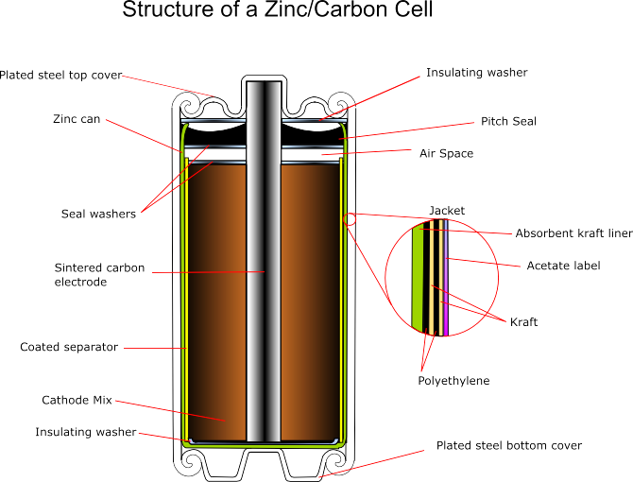
The zinc serves as both the container and the anode.
The manganese dioxide/carbon mixture is wetted with electrolyte.
A carbon rod is into the center, serves as a cathode.

Slide 20
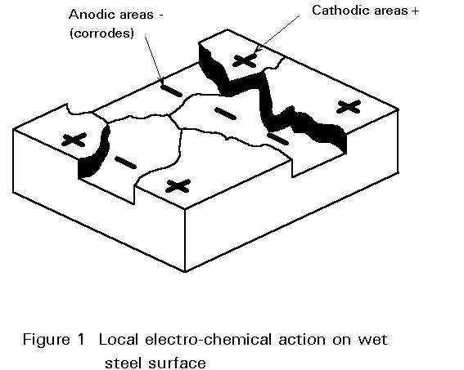

Slide 21
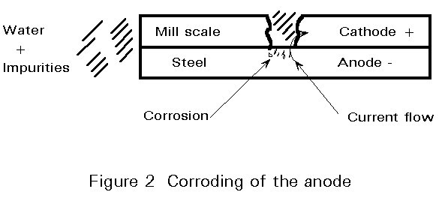

Slide 22
When dissimilar metals are connected in the presence of an electrolyte the more noble (cathodic) one tends to be protected while the more active (anodic or negative) corrodes rapidly.
As the potential difference between two dissimilar metals increases so does the possibility for galvanic corrosion.
The corrosion of metals is simply a reversion of their extraction process. 90% of marine and industrial corrosion is electro-chemical and the reaction approximates to that which takes place in a car battery.

Slide 23
Metals exposed to uncontrolled ‘normal’ atmospheres may corrode rapidly and by different mechanisms than those kept in pure, dry air - even if they are not exposed to rain.
In dry atmospheres, the growing oxide film usually protects the underlying metal, giving rise to ‘logarithmic’ or ‘square-root time’ law.

Slide 24
In uncontrolled atmospheres, the rate usually remains constant for a period, but may fall off when the film has grown to an appreciable thickness.
If the metal is exposed to rain it may corrode while it is wet at the rate appropriate to immersion in impure, well-aerated water, but the rate will fall when it dries.

Slide 25
Equation for predicting rates of atmospheric corrosion must therefore contain a term for
‘TIME OF WETNESS’
as well as for
        Average temperature,
        Average relative humidity,
        Atmospheric purity and so on …

Slide 26
Time of Wetness (TOW)
From the fundamental theory,
the Time Of Wetness (TOW) of a corroding surface is a key parameter,
directly determining the duration of the electrochemical corrosion processes.

Slide 27
Time of Wetness (TOW)
TOW is a complex variable, since all the means of formation and evaporation of the surface electrolyte solution must be considered
The TOW refers to the period of time during which the atmospheric conditions are favourable for the formation of a surface layer of moisture on a metal or alloy.

Slide 28
Time of Wetness (TOW)
This moisture film is extremely important from the point of view of the
chemical mechanisms of the corrosion process.
For the purposes of the standard this has been defined as the time period during which the relative humidity is in excess of 80% and the temperature is above 0º C.
This measure can either be determined from weather data or measured directly through various means.

Slide 29
Time of Wetness (TOW)
TOW categories range from
"Internal microclimates (T1) with climatic control"
to
"Part of damp climates, unventilated sheds in
humid conditions (T5)"
TOW units are hours per year (hours/year)
when relative humidity (RH) > 80% and the temperature > 0º C.

Slide 30
Time of Wetness (TOW)
TOW <= 10 | T1
10 < TOW <= 250 | T2
250 < TOW <= 2,500 | T3
2,500 < TOW <= 5,500 | T4
5,500 < TOW | T5

Slide 31
Apart from the primary critical humidity
(associated with clean surfaces),
secondary and even tertiary critical humidity levels may be observed where the corrosion rate increases abruptly.
Hygroscopic corrosion products and capillary condensation of moisture in corrosion products are thought to account for these effects.

Slide 32
Other sources of surface electrolyte include chemical condensation
(by chlorides, sulfates and carbonates),
adsorbed molecular water layers
and
direct moisture precipitation
(ocean spray, dew, rain).

Slide 33
Serious discrepancies between that artificial threshold have been observed in cold countries of the world.
The presence of salts on a surface is a well documented and useful freezing depressant.
Stating that there is no corrosion activities below
o˚ C appears to be a troubling flaw in the ISO 9223 framework.

Slide 34
WHY TO PROTECT STEEL?
Electro-chemical corrosion can be highly concentrated at certain points.
There are a number of reasons why local corrosion can be so concentrated:
  The first reason is related to the presence of mill scale.
  Much of the structural steel, which is use, is hot-rolled. The white-hot steel is formed into structural sections by passing it through compressing rollers.

Slide 35
  In some parts of the process, water is poured upon the forming steel. Both these operations cause an oxide layer to be built-up on the steel's surface.
The oxide layer on hot-rolled mild steel is called mill scale. It is physically unstable.
It is a separate entity from the steel in much the same way as is a coat of paint.
The mill scale is not a continuous layer and does not represent a protective barrier.

Slide 36
The mill scale is cathodic and the steel anodic. If there are a few breaks in the scale layer, a little condensation with dissolved impurities to act as the electrolyte, and perhaps some dissolved oxygen, then a corrosion cell is formed in which the steel dissolves (corrodes) away.
Small bare areas of steel in large patches of intact mill scale, i.e. large cathodic areas, give rise to intense attack and severe pitting of the steel.

Slide 37
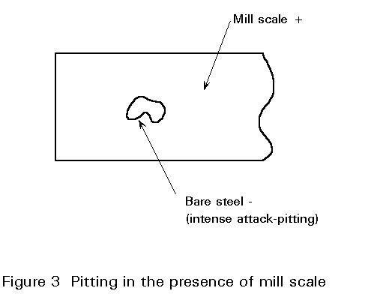

Slide 38
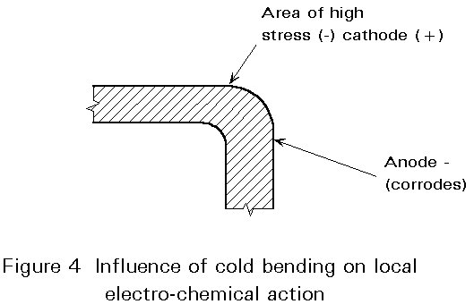
Fifth, cold bending, welding, etc. can produce highly stressed areas with adjacent anodic (-) and cathodic (+) patches.
Sixth, crevice corrosion occurs in the low oxygen concentration areas of a corrosion cell.
Seventh, even cold-formed steel has anodic and cathodic areas allowing electro-chemical corrosion to occur.

Slide 39
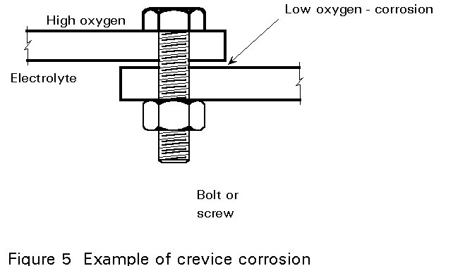
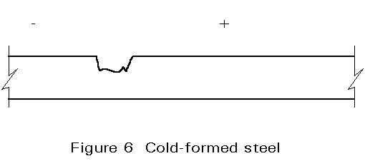

Slide 40
PROTECTING STRUCTURAL STEELWORK
Some fundamental practical considerations.
Effect of Environment and Surface Conditions
Corrosion is most likely to occur when one or more of the following is present:
  High humidity - which provides the essential water, i.e. humidity > 60%.
  Atmospheric pollution - to provide impurities, e.g. sulphides and chlorides.
  The presence of mill scale with breaks or discontinuities - the scale becomes the positive (cathode) pole and the steel the negative, dissolving or corroding (anode) pole in the corrosion cell.

Slide 41
Before deciding how to protect any steel, answering the
following will help produce the answer:
  What is the general environment?
  Is the environment likely to change in the foreseeable future? If it is, what is the cause and how will it alter the general environment?
  Is there local pollution, e.g. sulphur dioxide, which could make the environment more aggressive than is first apparent?
  In terms of environment must the project be divided into different parts when determining the protective system(s) or can the worst case be applied everywhere to simplify matters?

Slide 42
Before deciding how to protect any steel, answering the
following will help produce the answer:
  What special conditions apply, e.g., watersplash, residual pools, which may exclude the use of specific coatings?
  Can the protective system chosen be maintained effectively and economically throughout the required life of the structure/plant?

Slide 43
PROTECT WITH WHAT?
The most practical way to protect steel is by applying another coat either to act as an anode (i.e. dissolving in preference to steel), as a barrier, or both.
The common protective coatings are paints, hot dip galvanising, zinc or aluminium metal spray and any of the last three over coated with paints.

Slide 44
SURFACE PREPARATION
Surface preparation is a major influence in determining the protective value of a coating system. For metallic coatings it is usually an integral part of the manufacturing process and is included in the relevant national and European standards.
For paints the type and standard of surface preparation should be specified as a part of the protective coating treatment.
The importance of removing mill scale is well established. The methods used for this purpose and, to remove rust, etc.

Slide 45
WEATHERING
Because the layer of mill scale is a physically unstable separate entity, which breaks up before it leaves the rolling mills, the practice of "leaving the steel to weather" still exists.
Unfortunately, the duration of weathering necessary to remove the scale from structural steel depends on the local climate, the type of mill scale, it's thickness, the shape and thickness of the section and, when weathering takes place after the steel is erected, by the position of the individual structure.
Weathering is not recommended as a preparatory method.

Slide 46
CHIPPING, SCRAPING AND WIRE BRUSHING
Chipping, scraping and wire brushing are by far the least effective methods. They do not remove deep-seated rust, or tightly adhering mill scale.
PNEUMATIC DESCALING PISTOLS
A bunch of hardened steel needles is held loosely in the collar of the pistol.

Slide 47
FLAME CLEANING
An intensely hot oxy-acetylene flame is played on the surface. Differential expansion causes the mill scale to detach. The process is extremely slow, but it can be effective. It will nor remove tight mill scale. It cannot be used upon steel, which is less than 5mm thick, because it may cause buckling. In addition, it may "burn-in" chemicals deposited on the surface causing premature paint failures.

Slide 48
ACID PICKLING
This is a factory process for use on new steel before erection. The steel is immersed in hot sulphuric or hydrochloric acid; after rinsing it may be dipped in a weak phosphoric acid solution which deposits a thin crystalline phosphate coating upon the surface of the steel. This coating gives a very low level of protection against corrosion for a limited period.
ABRASIVE BLAST CLEANING
This is an extremely effective method of removing mill scale and rust. Its advantage is the profile which is produced and upon which the applied coating "keys".

Slide 49
OTHER CONSIDERATIONS
Surface Cleanliness
Surface Roughness
Chemical Cleanliness
  too often is confused with surface cleanliness by the specifier. Rust formed in industrial or marine environments can contain soluble salts. These salts are often found in corrosion pits and are rarely removed by abrasive blast cleaning and never by mechanical or hand cleaning. If overcoated they lead to rapid coating failure.

Slide 50
OTHER CONSIDERATIONS
Chemical Cleanliness
  Wet abrasive blast cleaning or washing with potable water are both used as a means of cleaning chemically contaminated steelwork. Unfortunately standard methods are not available for the qualitative or semi-quantitative determination of the levels of chlorides, sulphates or soluble iron salts on freshly blast-cleaned steel. Methods are being developed and may be included in ISO 8502 and 8504.

Slide 51
CATHODIC PROTECTION
The phenomena of galvanic corrosion and the galvanic series are the basis of Cathodic Protection (CP), a system in which the structure to be protected is made the cathode.
Setting up a cathodic protection system on an immersed or semi-immersed structure requires expert advice. There are however three points to remember when considering a CP system.
  To do their job, sacrificial anodes must corrode! They require regular inspection to ensure they are replaced before they disappear completely.

Slide 52
CATHODIC PROTECTION
  There must be sufficient anodes to give the correct current density over the complete surface to be protected.
  In systems using an external DC supply the polarity of the electrical connection is vital. Reversed connections can cause extremely rapid corrosion of the item the system is supposed to protect!

Slide 53
Corrosion cell and Cathodic protection
(Schematic)

Slide 54
STAINLESS STEEL
The resistance to atmospheric corrosion associated with stainless steel stems largely from its chromium content which helps to form a thin protective oxide layer which is also aesthetically pleasing.
There are three types of stainless steel currently used in buildings and it must be said that in-service failures are more often due to mis-specification than to inherent weaknesses in the products. Stainless steels do corrode!
Stainless steel components are expensive (x 10 the cost of carbon steel) and merit careful consideration before specifying to ensure their full potential is realised.

Slide 55
WEATHERING STEELS
Wet interiors, immersed or buried conditions are unsuitable environments in which to use weathering steels. Undoubtedly specialist advice from the steel industry is required before this type of steel is specified. There are a number of general considerations:
  For long life a corrosion allowance must be considered because the actual loss varies with the environment.
  Crevices and other water/dirt traps must be designed out.
  As the steel begins to weather iron hydroxides may run to adjacent surfaces and cause straining.

Slide 56
WEATHERING STEELS
  Fasteners should be made of weathering steel.
  Specific low alloy welding rods are needed.
  To obtain even weathering, blasting overall may be necessary.
  These steels are unsuitable for use in marine and aggressive industrial environments.

Slide 57
CONCLUDING SUMMARY
  Corrosion follows established chemical laws. In `dry' conditions it is generally inactive. In `wet' condition it is highly active.
  The `wet' conditions in which corrosion can take place can range from acid, neutral through to alkaline.
  Corrosion also occurs between dissimilar metals, the less noble (anodic) being the one destroyed.

Slide 58
Corrosivity
KSC has the highest corrosivity of any test site in the continental United States. This means samples exposed at this site will weather or degrade at rates far in excess of the rates experienced at other sites. The chart below shows the relationship between salt deposition, corrosion, and distance from the ocean.

Slide 59
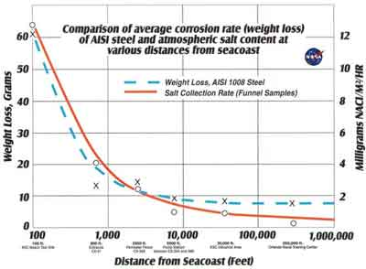
The Atmospheric Exposure Site (Kennedy Space Center, FL) J.D. Morrison, Report on the Relative Corrosivity of Atmospheres at Various Distances from the Seacoast, NASA-KSC Report MTB 099-74

Slide 60
Continuous Atmospheric Condition Monitoring
Continuous on-line monitoring of the following parameters is recorded and can be transmitted to any location:
Temperature
Humidity
Wind speed and direction
Rainfall measured in 20 minute increments recorded and archived by day, month, year, etc.
Total incident solar radiation
UVB radiation.
----------------------------------------------

